Slide 1
Problem Statement
Develop a 2D Occupancy Grid Map of a Room using Overhead Cameras
Developing cost-effective and accurate methods for environment mapping is crucial for enhancing the navigation capabilities of Autonomous Mobile Robots (AMRs) in indoor settings. While traditional LIDAR-based approaches offer high accuracy, they are expensive and complex. There is a need for a more affordable solution using overhead RGB cameras to generate precise 2D occupancy grid maps. Challenges include achieving reliable camera calibration, handling varying lighting conditions, and ensuring efficient real-time data processing to support AMR navigation effectively. This project aims to explore and address these challenges using ROS 2 Foxy and Gazebo simulation, demonstrating the feasibility of overhead RGB cameras for AMR environment mapping.

Slide 2
Unique Idea Brief (Solution)
This project proposes an innovative approach to develop a detailed 2D occupancy grid map of indoor environments using ROS 2 Foxy, Gazebo simulation, and a network of four overhead RGB cameras. By integrating these technologies, the solution aims to achieve accurate environment mapping essential for enhancing Autonomous Mobile Robot (AMR) navigation capabilities. Advanced camera calibration techniques ensure precise spatial mapping, while real-time image processing algorithms enable the identification of occupied and unoccupied spaces. This integrated approach not only facilitates cost-effective environment mapping but also lays the foundation for robust AMR path planning and obstacle avoidance in dynamic indoor settings.

Slide 3
Features Offered:
Precision through Calibration: Utilizes advanced camera calibration techniques for accurate spatial mapping, minimizing distortion.
Real-time Image Processing: Sophisticated algorithms enable identification and classification of occupied and unoccupied spaces, supporting dynamic updates to the occupancy grid map.
Integration with ROS 2 Foxy: Facilitates efficient communication and data exchange between cameras and the AMR's control system for enhanced autonomy.
Simulation in Gazebo: Allows for testing and optimization in a virtual environment, ensuring robust performance across diverse indoor scenarios.
Cost-effective Mapping: Uses overhead RGB cameras for cost-effective environment mapping, maintaining accuracy without the expense of LIDAR sensors.
Scalability: Modular design supports deployment in various room sizes and configurations, adapting to different operational needs.
Enhanced Navigation: Provides AMRs with detailed spatial awareness for optimized path planning, obstacle avoidance, and navigation in dynamic indoor environments.

Slide 4
Novelty of Approach
Integration of ROS 2 Foxy and Gazebo: Utilizes industry-standard robotics middleware and simulation tools for enhanced scalability and real-time performance in indoor environment mapping.
Overhead RGB Cameras: Replaces costly LIDAR sensors with cost-effective RGB cameras, maintaining mapping accuracy while lowering deployment costs.
Advanced Calibration and Real-time Processing: Employs precise camera calibration and sophisticated real-time image processing algorithms for accurate occupancy grid map generation crucial for AMR navigation.
Simulation-based Optimization: Tests and optimizes algorithms within Gazebo simulation, ensuring robust performance across diverse indoor scenarios before physical deployment.
Modular and Scalable Design: Features a modular architecture adaptable to various room configurations, promoting flexibility and future scalability in robotics applications.

Slide 5
Methodology
This project utilized four overhead RGB cameras and ROS 2 Foxy for real-time data processing. After precise camera calibration to minimize distortions, real-time algorithms in ROS 2 Foxy processed captured images to identify occupied and free spaces. The processed data was then converted into a 2D occupancy grid map. Validation in Gazebo simulated various conditions to assess accuracy and performance. Iterative improvements refined camera calibration and algorithms, ensuring robustness for AMR navigation in dynamic indoor environments. The solution was developed using four overhead RGB cameras and integrated with ROS 2 Foxy for real-time data processing and communication. Key steps included:
Hardware Setup: Four overhead RGB cameras were strategically positioned in the simulated indoor environment.
Camera Calibration: Precise calibration ensured accurate spatial mapping by minimizing optical distortions.
Data Processing: Real-time image processing algorithms in ROS 2 Foxy performed object detection and segmentation to classify areas as occupied or free.
Occupancy Grid Mapping: Processed data was converted into a 2D occupancy grid map, representing the environment's spatial layout.
Validation in Gazebo: The solution was tested and validated in the Gazebo simulation environment for accuracy and performance under various conditions.
Iterative Refinement: Feedback from validation drove iterative improvements in camera calibration, algorithms, and overall mapping accuracy.

Slide 6
Advantages:
Accuracy: The use of precise camera calibration and real-time image processing algorithms ensures accurate 2D occupancy grid mapping, crucial for reliable AMR navigation in indoor environments.
Cost-effectiveness: Compared to traditional LIDAR-based solutions, our approach with overhead RGB cameras significantly reduces deployment costs while maintaining mapping accuracy.
Scalability: The modular design and integration with ROS 2 Foxy facilitate scalability across various room sizes and configurations, adapting to diverse operational needs without major hardware changes.
Real-time Processing: Efficient real-time processing within ROS 2 Foxy allows for dynamic updates to the occupancy grid map, enabling responsive navigation and obstacle avoidance for AMRs.
Simulation Validation: Testing and validation in the Gazebo simulation environment ensure robust performance under different conditions, minimizing deployment risks and optimizing system reliability.

Slide 7
Limitations:
Dependency on Lighting Conditions: Performance may vary under challenging lighting conditions, affecting the accuracy of image processing algorithms and thus the quality of the occupancy grid map.
Computational Complexity: Real-time image processing requires significant computational resources, potentially limiting the scalability of the solution in terms of processing speed and hardware requirements.
Calibration Sensitivity: Achieving and maintaining precise camera calibration is crucial for accurate mapping. Any deviations or inaccuracies in calibration can impact mapping quality and system performance.
Environmental Dynamics: Changes in the environment, such as moving objects or dynamic lighting, may pose challenges to real-time image processing algorithms, affecting the reliability of the occupancy grid map updates.
Initial Setup Complexity: Setting up and calibrating multiple overhead RGB cameras and integrating them with ROS 2 Foxy requires technical expertise and careful configuration, adding complexity to the initial deployment phase.

Slide 8
Process Flow
START
Ubuntu 20.04
Initializing ROS2 Foxy
Setup environment for mapping
Gazebo Simulation
InfraCam
Configure and Calibrate Overhead Cams
Capture and Implement Image Processing Algorithms
Generate Occupancy Grid Map
Generate Occupancy Grid Map
END
2D Occupancy Map was Obtained

Slide 9
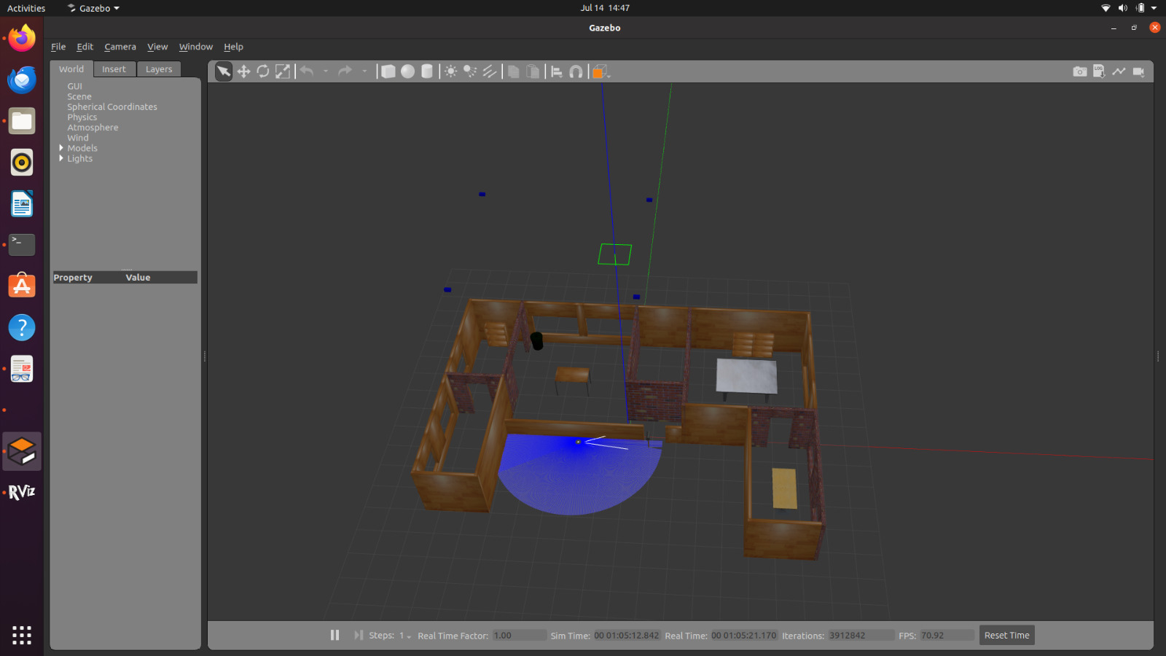
Architecture Diagram

Slide 10
Results
The project involves developing a 2D occupancy grid map for indoor environments using overhead RGB cameras and ROS 2 Foxy in a Gazebo simulation. This innovative approach aims to offer a cost-effective alternative to traditional LIDAR-based mapping methods, focusing on accurate and real-time spatial mapping to enhance Autonomous Mobile Robots (AMRs) navigation.
Key features include precise camera calibration, real-time image processing, and simulation-based optimization. While offering advantages like accuracy, cost-effectiveness, and scalability, challenges include dependency on lighting conditions and computational complexity.
The project demonstrates the feasibility of using overhead cameras for effective AMR navigation.

Slide 11
Conclusion
Initially, we have model and simulate the room environment, objects, and overhead cameras in the Gazebo simulator. Gazebo will also support the addition of an AMR equipped with an on-board camera or LiDAR for SLAM map generation and navigation using the ROS2 navigation stack. This will allow for a comparison between the map generated from the overhead cameras and the map created by the AMR using SLAM.
A map is created using the overhead cameras.

Slide 12
Team Members and Contribution
Sriram S Rajan – Simulation and Mapping
Richu K Mathew – Simulation and Mapping
Sneha Mariam Shaji – Simulation and Mapping
Abi Talib – Report and Documentation
Rohith Santhosh – Report and Documentation

